Slide 1
TEXT GENERATION

Slide 2
1. PDF Upload & Text Extraction
The user uploads a .pdf file.
The app uses PyPDF2 to extract all the text from the PDF pages.
2. Dynamic Chunking
The extracted text is split into chunks (default range: 100–300 words).
The chunk size is calculated automatically based on the number of tokens in the document to stay within the LLM's context limit (e.g., 4096 tokens).
3. Embedding the Text
Each chunk is encoded into a dense vector using the all-MiniLM-L6-v2 SentenceTransformer.
The user’s query is also embedded into a vector using the same model.

Slide 3
4. Context Retrieval
Cosine similarity is calculated between the user’s query and all the chunks.
The top 3 most relevant chunks are selected as context.
5. LLM Answer Generation
A prompt is constructed with the selected context and user question.
This prompt is sent to the locally running Mistral 7B Instruct model via llama_cpp.Llama.
The model returns a generated answer based on the provided context.
6. Display Output
The app shows the AI-generated answer in the Streamlit interface.

Slide 4
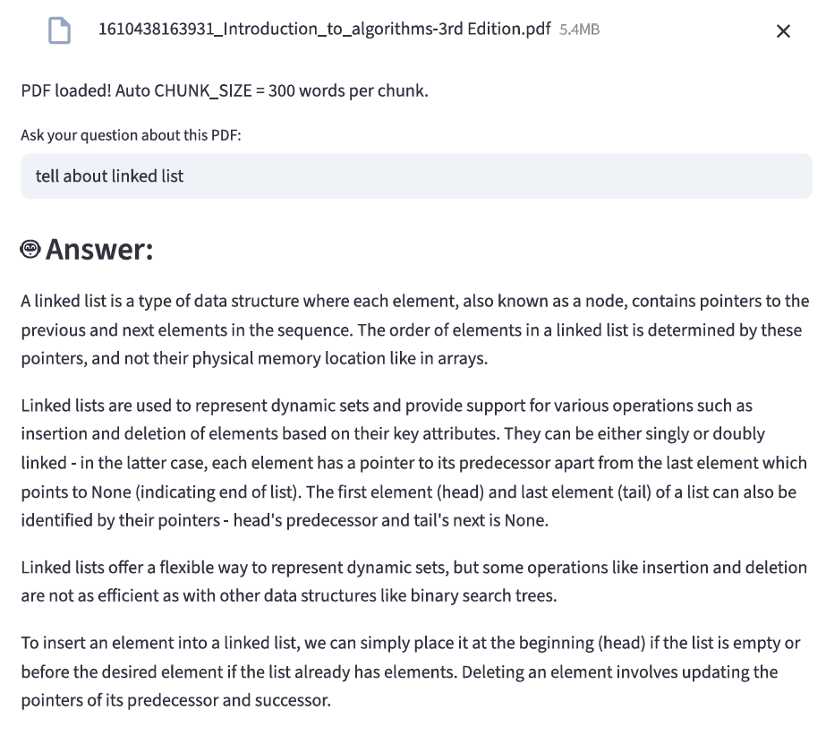

Slide 5
Stage | What Happens | Typical Time
PDF I/O & text parsing | PyPDF2 reads pages serially | ~90 s
LLM prompt‑eval Mistral 7B evaluates ~180 s

Slide 6
Interruption Handling

Slide 7
Interruption Handling
When a robot/LLM is teaching and gets interrupted (e.g., student asks a question, external noise), it should:
Pause immediately (don’t keep talking like a broken recorder).
Resume later by:
"Where we stopped…" + repeat last 1-2 sentences.
"Let’s recap…" + give a 10-second summary of recent content.
import threading
from queue import Queue
# Shared queue for Team 1's inputs
input_queue = Queue()

Slide 8
def teaching_loop(topic):
while True:
# Generate & send teaching content to Team 3
chunk = llm.generate_chunk(topic) # Stream output chunk-by-chunk
send_to_team3({"type": "teach", "text": chunk})
# Check for interruptions (non-blocking)
if not input_queue.empty():
interruption = input_queue.get()
handle_interruption(interruption) # Pause/answer
break # Exit loop if interrupted
def listen_for_interruptions():
while True:
data = receive_from_team1() # Waits here for Team 1's input
input_queue.put(data) # Pass to teaching thread

Slide 9
# Start threads
threading.Thread(target=listen_for_interruptions, daemon=True).start()
teaching_loop("photosynthesis")
Input-
Student Question - {text: "What is photosynthesis?", intent: "doubt"} - Answer doubts naturally.
Interruption Flag - {type: "interruption", source: "noise/student"} - Pause/resume teaching.
Classroom Context - {topic: "biology", student_age: 15, noise_level: 0.7} - Adjust complexity/engagement.
Output-
Normal Teaching - {type: "teach", text: "Photosynthesis is..."} - Convert text to speech.
Answering Doubt - {type: "answer", text: "Chlorophyll is..."} - Speak the answer.
Pause/Resume - {type: "pause"} or {type: "resume", text: "Recap:..."} - Pause audio or recap.

